Slide 1
Testing Session-3

Slide 2
Agenda
Smoke Testing
Sanity testing
Test data preparation Techniques

Slide 3
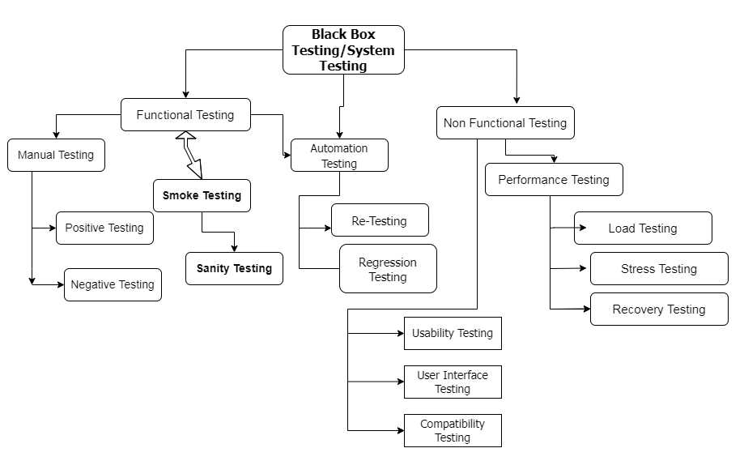

Slide 4
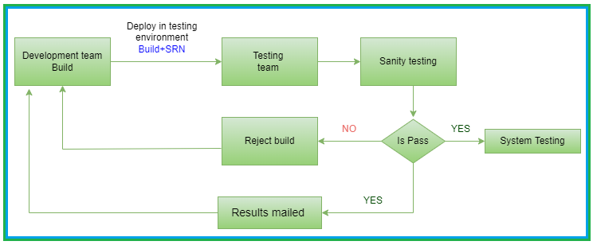
Smoke Testing

Slide 5
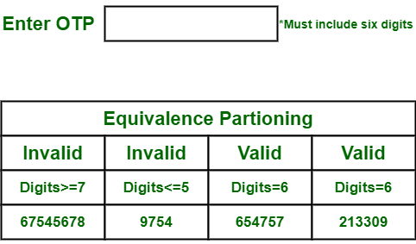
Equivalence Class Partitioning(ECP)
We have to identify all possible
Valid inputs & invalid inputs, then
divide them into groups.
While making groups make sure
that every input data that belongs to
a group is producing same output.

Slide 6
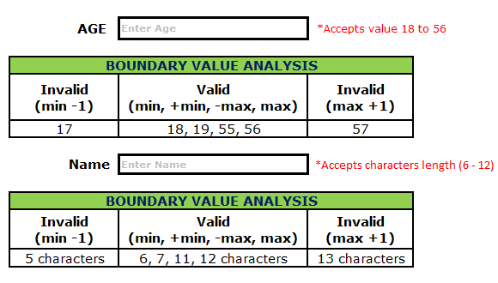
Boundary Value Analysis(BVA)
min= Pass
Max=Pass
min-1=Fail
min+1=Pass
Max-1=Pass
Max+1=Fail

Slide 7
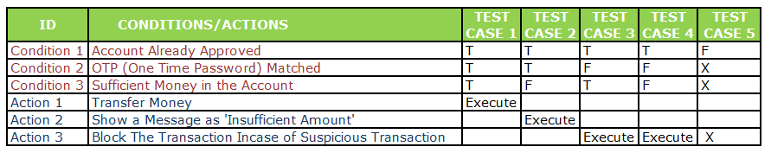
Decision Table Technique
Ex.1:
Ex.2 ::

Slide 8
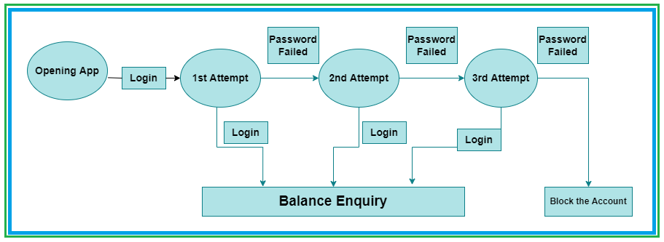
State Transfer Transition Technique

Slide 9
Why Swhizz?
Following the project-oriented training By working on user stories
Real time people will deliver the classes
Hands on experience.
One to One monitoring
Interaction sessions
Doubts Clarification Session
Expertise in resume preparation
Mock interviews
Job assistance
Associated with 50+ Clients
900+ students got placed

Slide 10

Any Queries?

Slide 11
Thank You
Mr.SubbaRao (Relationship Manager)
Contact:9059002244

